Slide 1



Laptop Price Prediction
by Chokhande Sameer
Roll no :- 10

Slide 2
Introduction
In today’s tech-driven world, laptops are essential tools — from students to professionals to gamers. With countless models, configurations, and brands on the market, choosing the right laptop at the right price can be overwhelming.

Slide 3
Problem statement
The laptop market is vast and rapidly evolving, with a wide range of specifications, brands, and performance levels driving price variations. For consumers, this creates confusion — How do you know if you’re getting the best value for money?

Slide 4

Economic Indicators & Market Dynamics
Currency Exchange Rates
USD/EUR, USD/CNY rates impact import/export prices.
Inflation Rates
Inflation impacts electronic goods prices.
Tariffs & Trade Policies
Trade wars impact component costs.
Consumer Demand
Gaming, business laptops, Chromebooks have different demands.
Economic indicators are important. Currency rates and inflation affect prices. Consumer demand also plays a role.

Slide 5
Key Factors Influencing Laptop Prices
Component Costs
Manufacturing & Assembly
Brand Value & Marketing
CPU (Intel, AMD)
Labor costs
Premium vs. budget brands
GPU (NVIDIA, AMD)
Supply chain
Marketing spend
RAM (DDR5, DDR4)
Storage (SSD, HDD)
Display (IPS, OLED)
Laptop prices depend on many factors. Component costs are a major driver. Brand value and marketing also play a role.

Slide 6



Methodologies: Machine Learning Algorithms
Decision Trees
Random Forests
Easy to interpret, handles categorical data.
Reduces overfitting, improves accuracy.
Gradient Boosting
High accuracy, handles complex relationships.

Slide 7
Data Collection & Feature Engineering
1
Data Sources
E-commerce, manufacturer websites, price comparison websites.
2
Data Preprocessing
Cleaning missing values and outliers. Transforming categorical variables.
3
Feature Engineering
Creating new features like screen resolution and storage capacity.

Slide 8
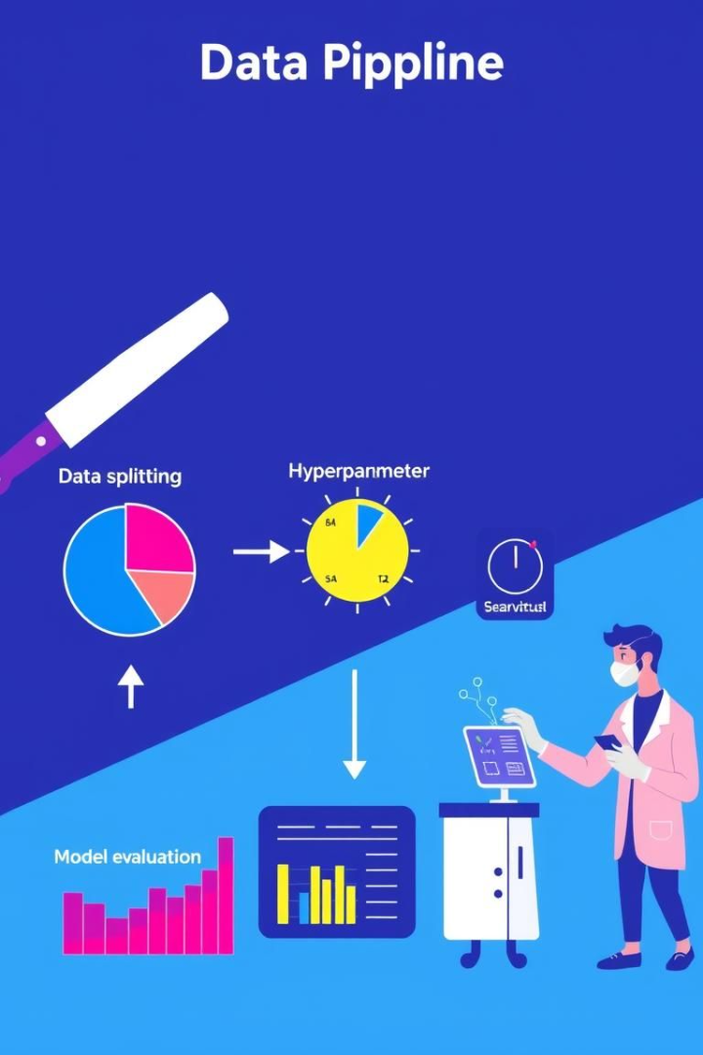



Model Training & Evaluation
Data Splitting
Training, validation, and test sets.
Hyperparameter Tuning
Grid search, random search, Bayesian optimization.
Model Evaluation
Comparing performance metrics on the test set.

Slide 9



Case Study: Predicting Prices of Gaming Laptops
1
Dataset
2
Model
3
Results

Slide 10
FUTURE SCOPE
1
Integrate real-time market data for dynamic pricing.
2
Enhance the model with user reviews and brand reputation scores
3
Expand to other devices like tablets and smartphones

Slide 11
Conclusion
Our Laptop Price Prediction project successfully demonstrates how machine learning can simplify complex pricing decisions in a fast-moving, feature-rich market.
🔹 Key Takeaways:
We identified the most influential features affecting laptop prices — like processor type, RAM, storage, and brand.
The prediction model accurately estimates prices, helping consumers make smarter, value-driven purchases.
Retailers and manufacturers can leverage this approach to set competitive prices, maximizing both sales and profit margins.

Slide 12
Thank you

